Slide 1
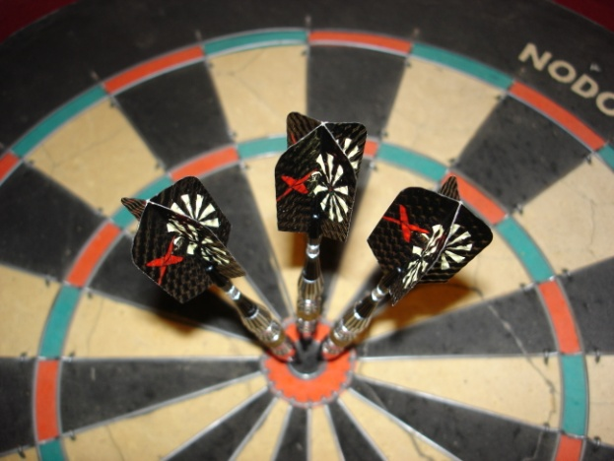
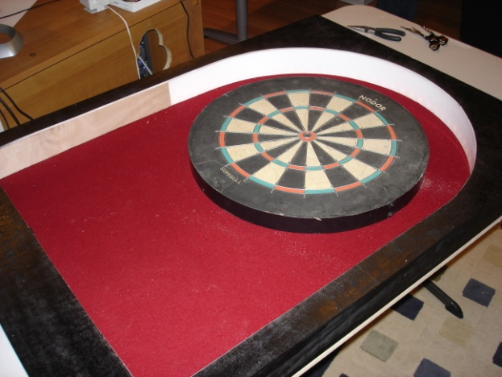
Dart Apart
Vision based dart scoring system.
Doug Love & Nick Cramer

Slide 2
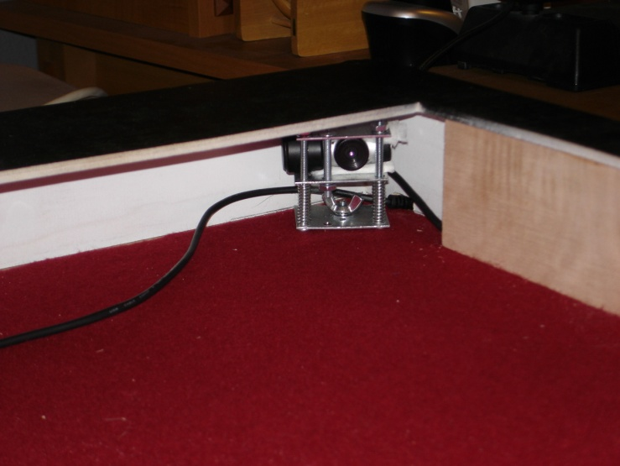
What is Dart Apart
Dart game system
Games –
Last Man Standing, Cricket, 301
Games can be added
Two USB web cameras
Detect the position of the darts

Slide 3
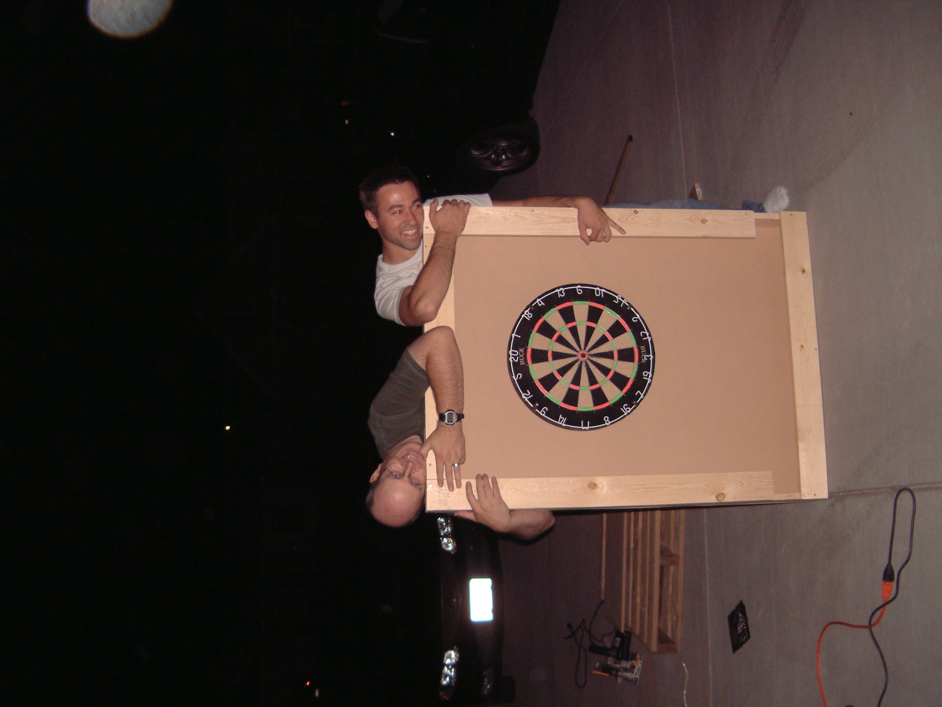
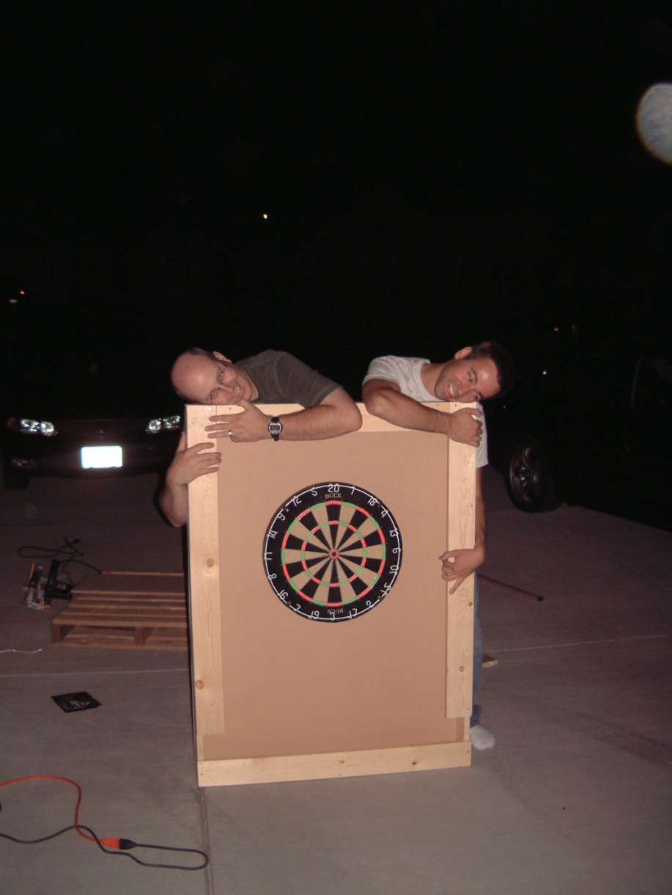
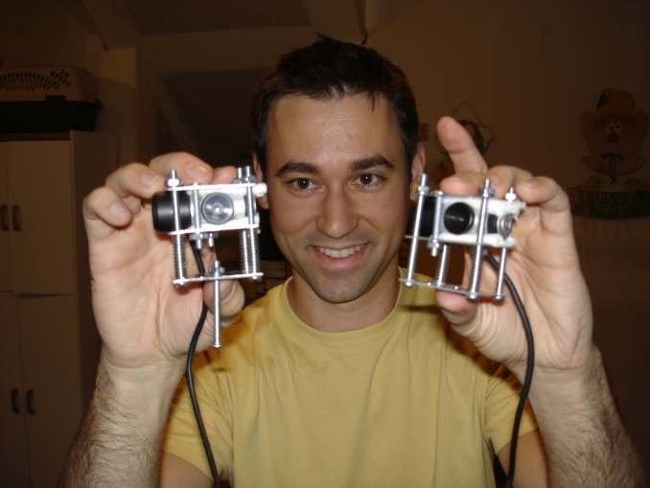
Why make Dart Apart?
We are geeks

Slide 4
Why make Dart Apart?
Play against each other over the internet
Almost there – further development is required
To see if we could build a working system

Slide 5
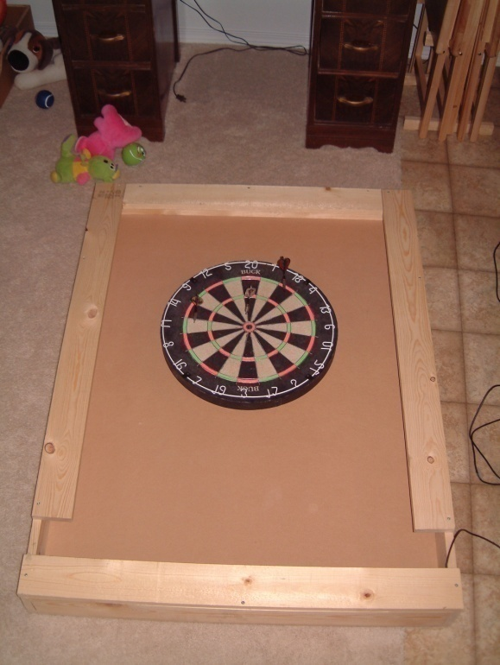
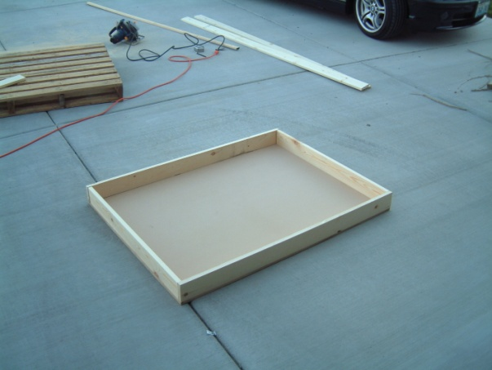
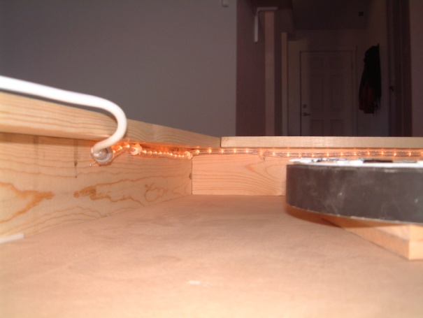
Hardware
Version 1

Slide 6
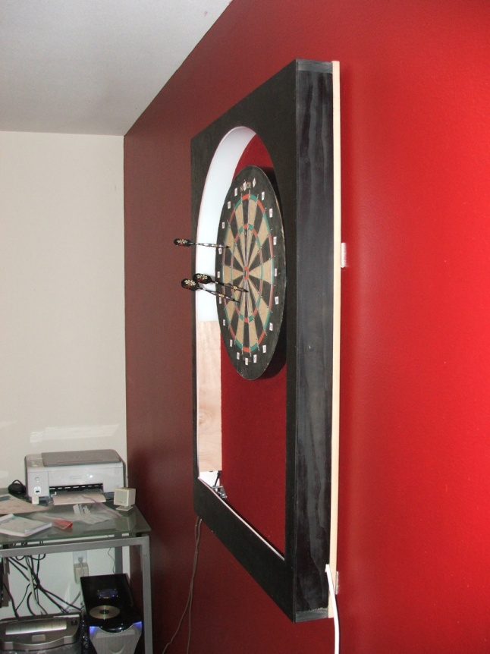
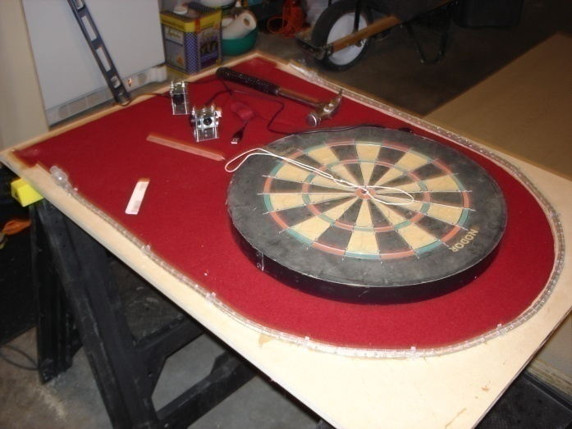
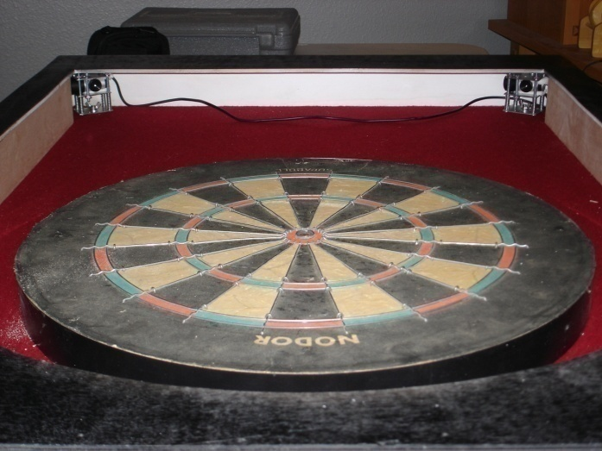
Hardware
Version 2

Slide 7
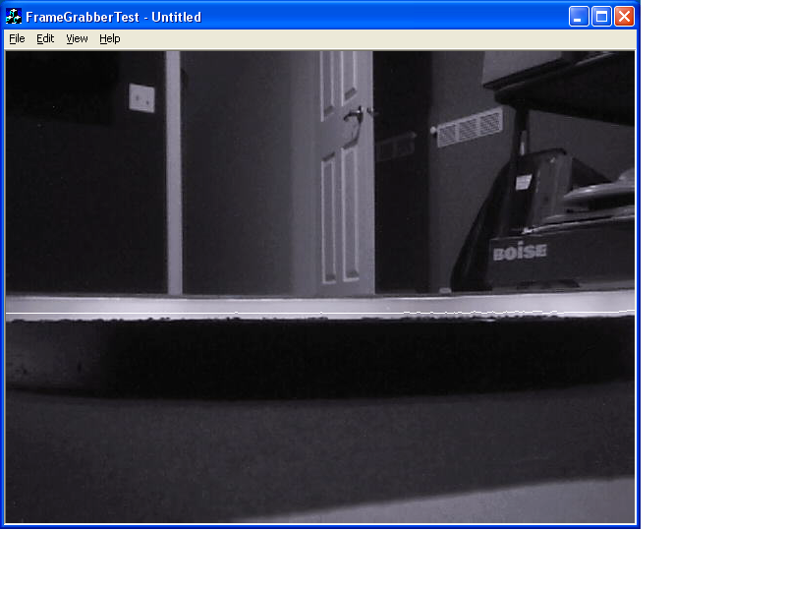
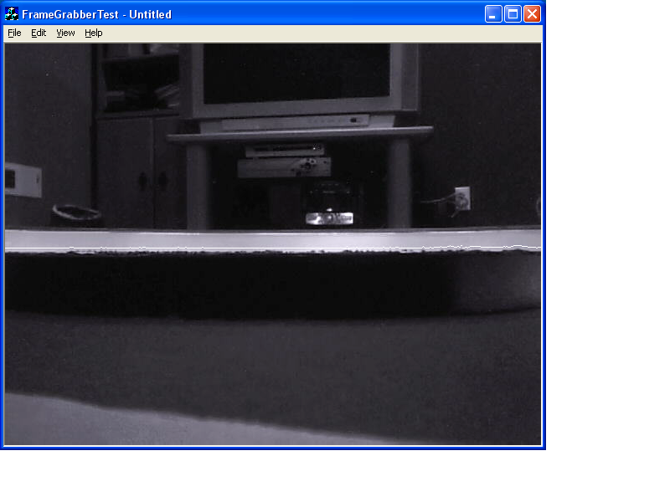
Software - Detecting the darts
Left camera
Right camera

Slide 8
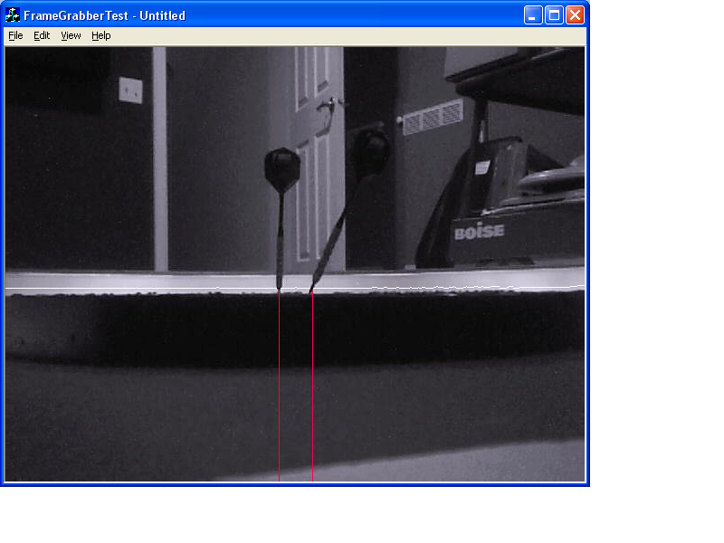
Software - Detecting the darts
Darts
Scan line
Dart board
Detected dart position

Slide 9
How do we detect the darts?
Walk across the scan line
Find the middle of where the color is black on the scan line
Return % from the left side to the game

Slide 10
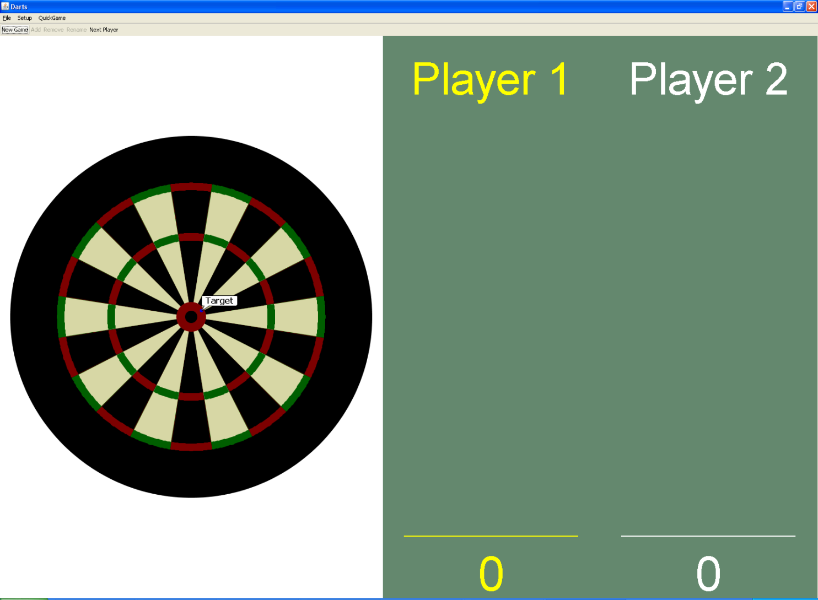
Software - Game

